Slide 1
Non-blocking commit protocols in Distributed System

Slide 2
Protocols that allow operational sites to continue transaction processing even though site failures have occurred are called non-blocking.
Atomic operation: either executes to completion or it appears never to have executed.
By definition, transaction on distributed database system is atomic operation.
In reality, a transaction is rarely a physically atomic operations.
The gap between logical atomicity and physical atomicity causes significant problems in distributed database implementation.

Slide 3
Preserving transaction atomicity is well understood in single site case.
Site decides to commit or abort when reaching commit point.
Unconditionally guaranteed, irreversible.
Problem occurs when more than one site is involved.

Slide 4
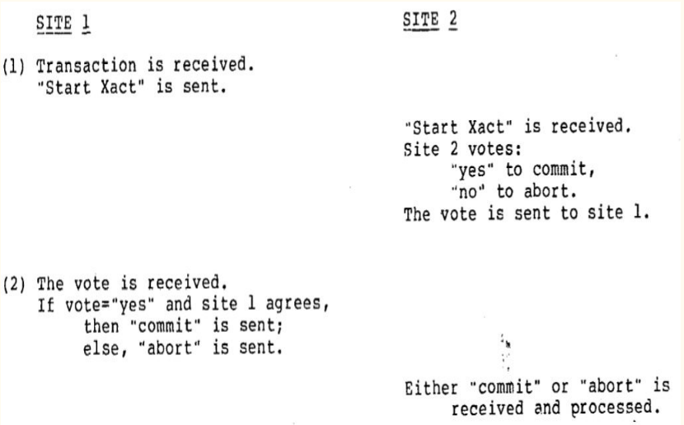
Two Phase Commit Protocol
The simplest commit protocol that allows unilateral abort.
An example of a blocking protocol.

Slide 5
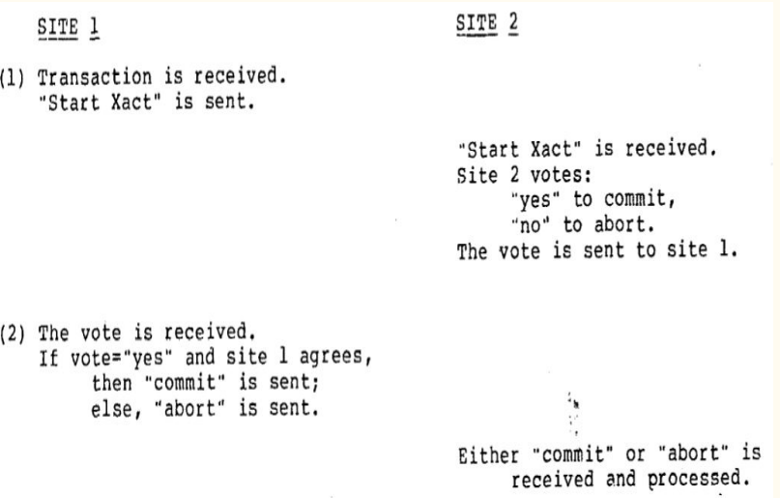
Two Phase Commit Protocol: Process
First Phase: coordinator distribute the transaction to all sites, and each site individually votes.
Second Phase: coordinator collects all the votes and informs outcome.

Slide 6
Two Phase Commit Protocol
Simplest and cheapest in number of messages, but can be block on site failures.
An example of a blocking protocol: operational sites sometimes wait on the recovery of a failed sites. Locks must be held on the database while the transaction is blocked.
A protocol that never requires operational sites to block until a failed site has recovered is called a non-blocking protocol.

Slide 7
Termination and Recovery Protocols
Termination Protocol: to terminate transaction execution as quickly as possible at the operational sites.
Recovery Protocol: invoked by failed sites to resume transaction processing.

Slide 8
Formal Model Describing Commit Protocols
Transaction execution at each site models as finite state automaton (FSA).
Network models as input/output tapes to all sites.
The states of the FSA for site i are called local states of site i.
State of transition: reading, writing, and moving to the next local state.

Slide 9
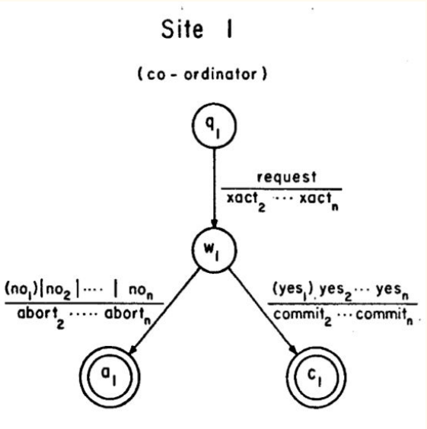
FSA for Two Phase Commit Protocol
Each FSA has four (local) states: initial (qi ), wait (wi ), abort (ai ), and commit (c i ).
Abort and commit are final states.

Slide 10
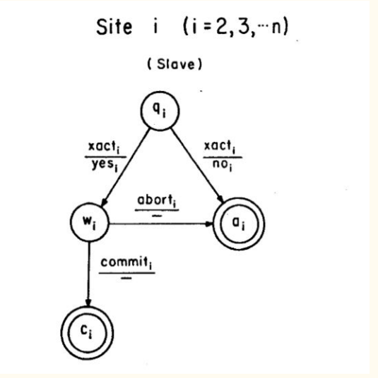
FSA for Two Phase Commit Protocol
Local state for site i are subscripted with i.
Messages sent or received by a slave are subscripted with that slave’s site number.

Slide 11
Properties for Commit Protocol
The FSA’s are nondeterministic.
The final states of the FSA’s are partitioned into two sets: the abort states, and the commit states.
The act of committing or aborting is irreversible.
The state diagram describing a FSA is acyclic.

Slide 12
Global Transaction States
Global state defines the complete processing state of a transaction.
A global state is said to be inconsistent if it contains both a local commit state and a local abort state.
A global state is said to be a final state if all local states contained in the state vector are final states.
A global state is said to be a terminal state if from it there is no immediately reachable successors.
A terminal state that is not a final state is a deadlock state.
The concurrency set of si state is the set of all local states s j , where i≠j, such that s i and s j are contained in the same reachable global state.

Slide 13
The Central Site Class Commit Protocol
The central site class: uses one site (coordinator) to direct transaction processing at all participating sites (slaves).
Properties:
1) Single coordinator；
2) All other participants execute the slave protocol；
3) Slaves can communicate only with coordinator；
4) Coordinator sends the same message and wait.
Advantages: Relatively cheap, conceptually simple.
Disadvantage: Vulnerability to a coordinator failure.
Synchronous within one state transition: one site never leads another site by more than one state transition during the execution of the protocol

Slide 14
The Decentralized Class Commit Protocol
The (fully) decentralized class: each site participates as an equal in the protocol and executes the same protocol.
Every site communicates with every other site.
Process: each site will send the identical message to every other site, then waits until it has received messages from all its cohorts.

Slide 15
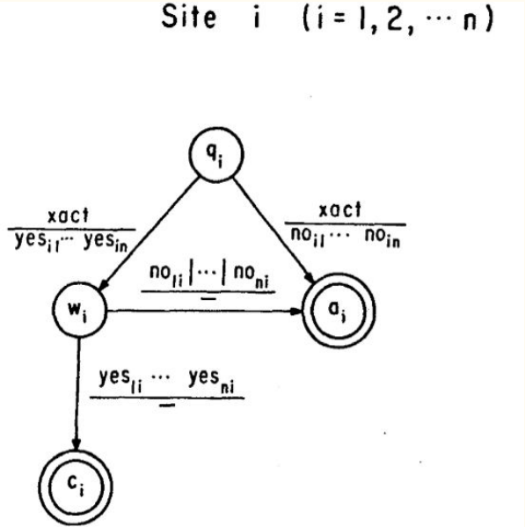
Decentralized Two Phase Commit Protocol
Simplest decentralized commit protocol.
First phase: each site receives the “start xact”, make the decision and sends to other cohorts.
Second phase: each site accumulates all the abort decisions and move to a final state.
Also synchronous within one state transition.

Slide 16
Fundamental Non-blocking Theorem
A protocol is non-blocking if and only if it satisfies:
1) there exists no local state such that its concurrency set contains both an abort and a commit state;
2) there exist no non-commitable state whose concurrency set contains a commit state.

Slide 17
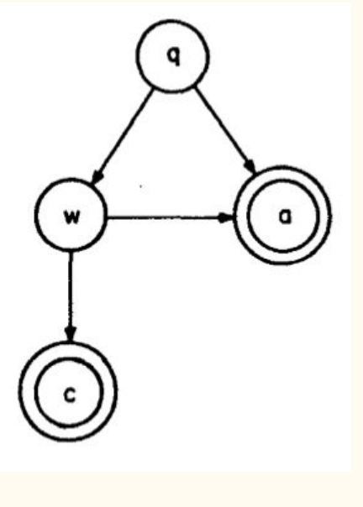
The Canonical Two Phase Commit Protocol
The concurrency set of state q contains q, w and a. The concurrency set of state w contains all of the local states of the protocol.
Lemma: A protocol that is synchronous within one state transition is non-blocking if and only if:
1) it contains no local state adjacent to both a commit and an abort state, and
2) it contains no non-committable state that is adjacent to a commit state.

Slide 18
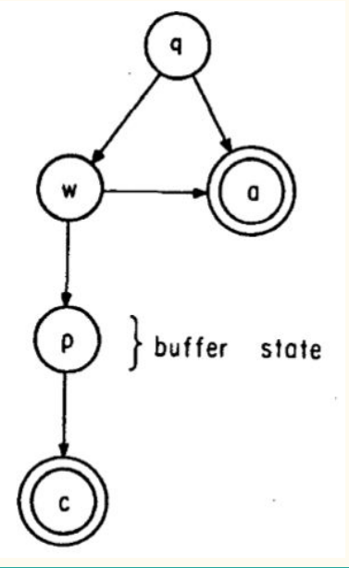
Buffer States and Canonical Non-blocking Protocol
The buffer state can be thought of a “prepare to commit” state (labelled as p in the graph).
This protocol can be referred as canonical non-blocking protocol, which is a three phase protocol.

Slide 19
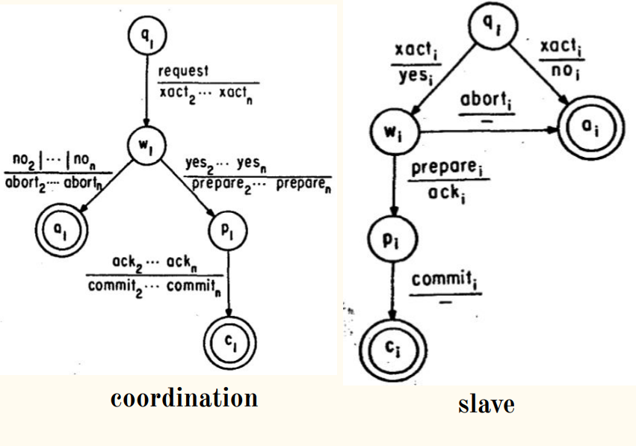
Non-blocking Central Site Protocol
The slave protocol is the three phase protocol.
The coordination protocol is also a three phase protocol that is a extension of the two phase coordinator protocol.

Slide 20
Termination Protocols
Site failures may occur and would make the continued execution of the commit protocol impossible. Solution: termination protocol.
A termination protocol can accomplish its task only if the current state of at least one operational site obeys the conditions given in the fundamental non-blocking theorem.
But in the worst case, it will be able to terminate correctly only if all of the operational sites obey the fundamental non-blocking theorem.

Slide 21
Central Site Termination Protocol and Backup
Choose a backup coordinator from the set of operational sites.
The backup coordinator will complete the transaction by directing all the remaining sites toward a commit or an abort. The protocol must be reentrant.
Decision Rule For Backup Coordinators:
If the concurrency set for the current state of the backup contains a commit state, then the transaction is committed.
Otherwise, it is aborted. -Phase 1: Issue a message and wait. -Phase 2: Issue a commit or abort.

